Slide 1
Welcome to Introduction to Web Scraping!
Please log onto the Etherpad:
https://pad.carpentries.org/2026-03-10-bham-intro-web-scraping
Add your details in the ‘Sign in’ section
Check if you have completed the Software Setup’

Slide 2
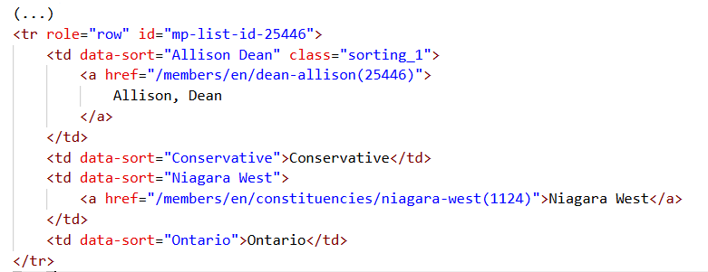
html code from Canadian MPs webpage

Slide 3
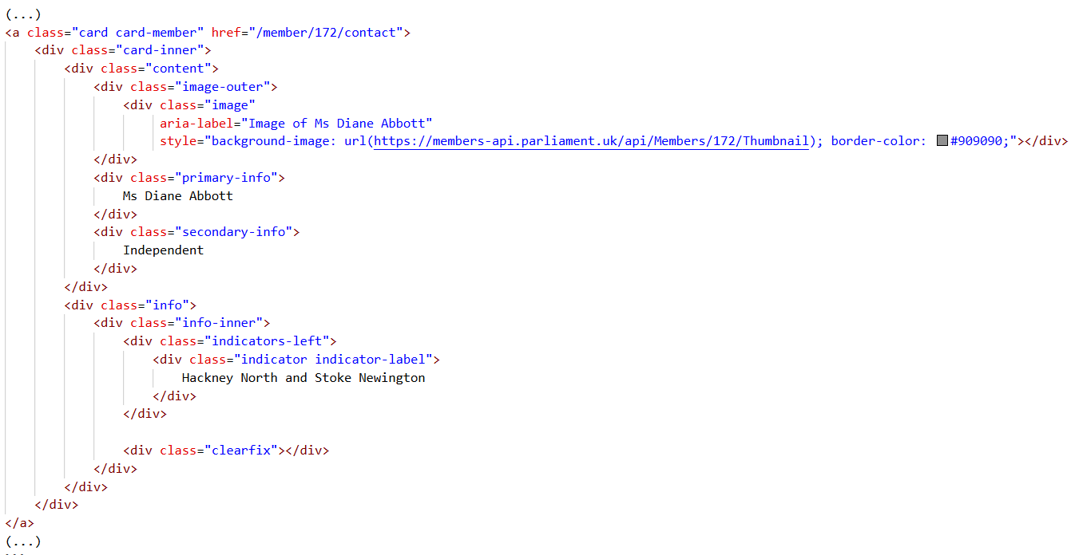
html code from UK MPs webpage

Slide 4
“Web scraping (web harvesting or web data extraction) is a computer software technique of extracting information from websites.”
Wikipedia https://en.wikipedia.org/wiki/Web_scraping
Web scraping typically targets one web site at a time to extract unstructured information and put it in a structured form for reuse.

Slide 5
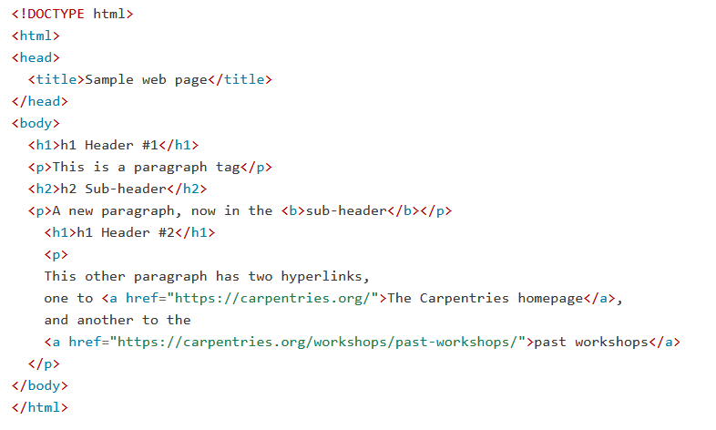
Hypertext Markup Language – html

Slide 6
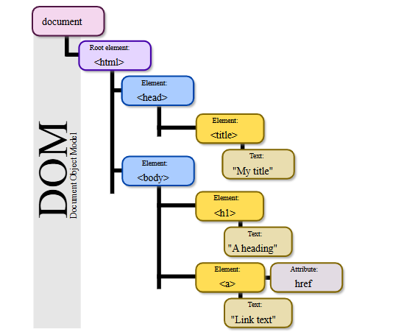
html Tree Format
Source: Wikipedia. Author: Birger Eriksson

Slide 7
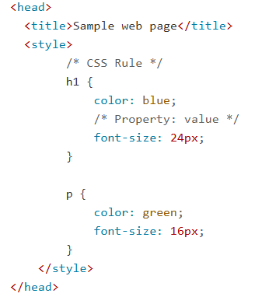
Cascading Style Sheet (CSS) Code

Slide 8
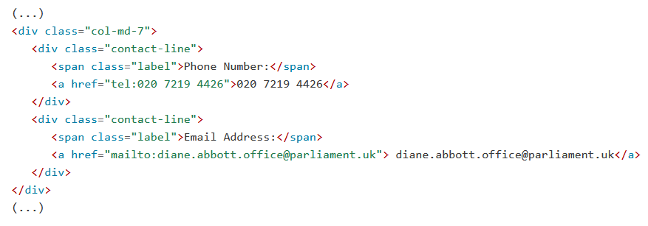
Email address
Selector: div.contact-line:nth-of-type(2) a

Slide 9
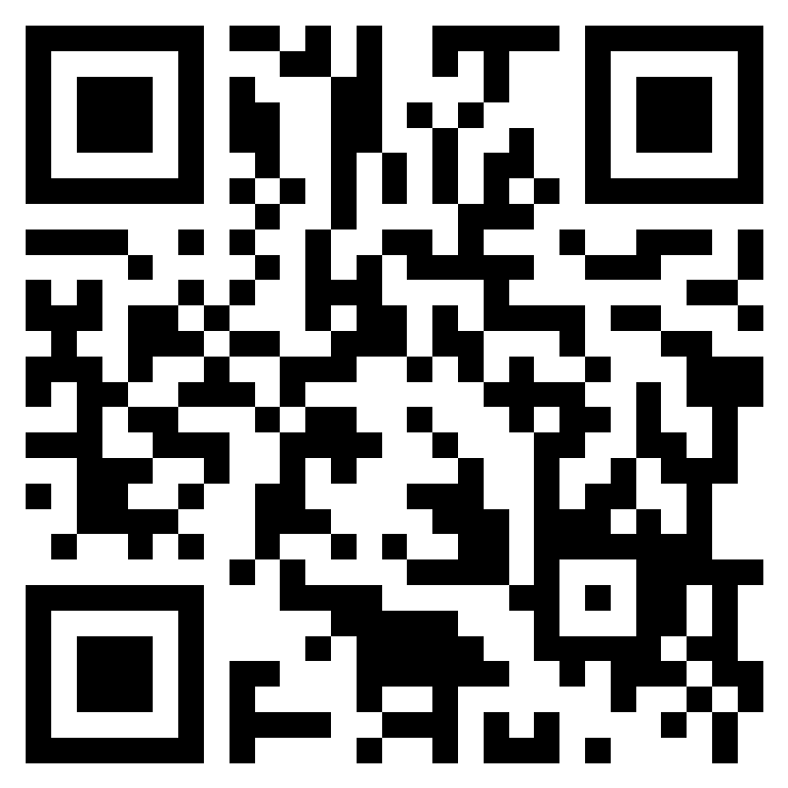
Please take a couple of minutes to fill in the course feedback form
Introduction to Web Scraping - 10 Mar 2026 - BEAR Training Feedback form – Fill out form

Slide 10
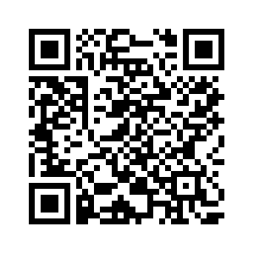

2026 IT Needs of Active Research Survey
Survey going live Monday 23 February for 4 weeks
Being sent to all research staff via new mailing list
PGR Leads being asked to send out to PGRs
Your opportunity to shape the future of research computing at UoB!
Received 5 years of funding for extra training based on 2024 results
Survey link
https://app.onlinesurveys.jisc.ac.uk/s/bham/2026-it-needs-of-active-research

